Slide 1

Guess it in a few seconds
Belli di Brutti
Alice Schirinà
Maria Luisa Croci
Giuseppe Stefanelli
Valerio Antonini
Daniele Sanna

Slide 2
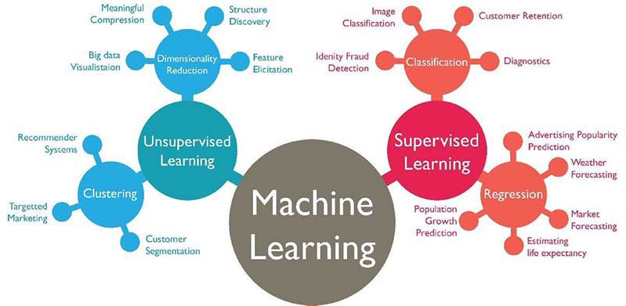
Goal : Music Genre Classification
The objective of this work is to classify songs for genre using Supervised and Unsupervised techninques.

Slide 3



Data collection
+
500 songs divided in 5 genres where registered using Science journal and Zeus app.
100 songs for every genre (Metal,Classic,Pop,Reggae and Elettronic )
3 sensors used :
‘PitchSensor’ which recorded tonality of a song in Hertz;
‘DecibelSource’ which recorded intensity of the sound in Decibel;
‘AmbientLightSensor’ which recorded the ambient brighteness in Lux of our strobe (for each song Zeus generate light like a strobe)
Save every song in a csv file

Slide 4
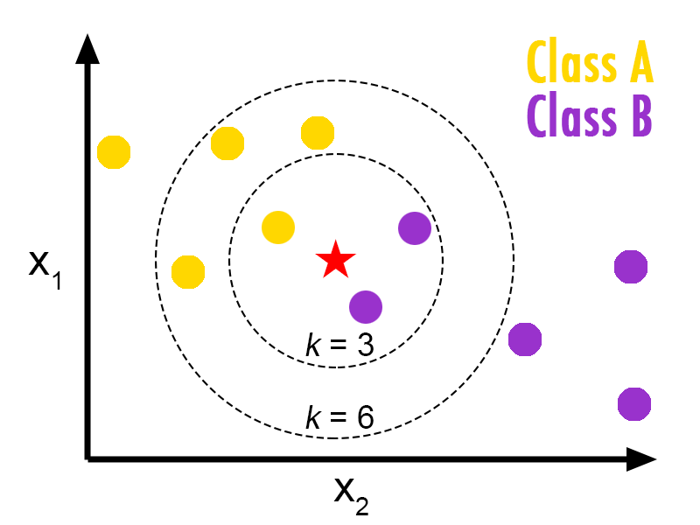
Data Imputing
All missing values present in every csv file is filled with K-NN algorithm creates a basic mean impute then uses the resulting complete list to construct a KDTree. Then, it uses the resulting KDTree to compute nearest neighbours (NN). After it finds the k-NNs, it takes the weighted average of them.

Slide 5
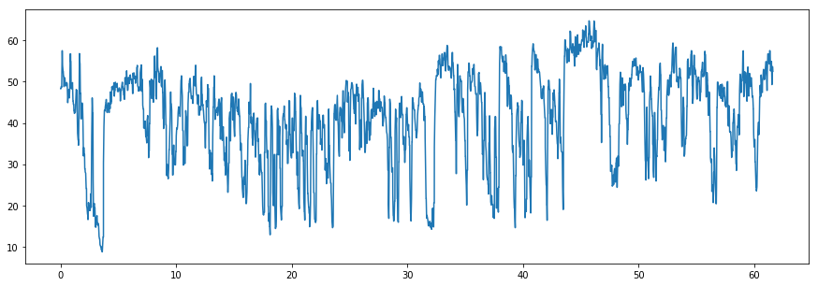
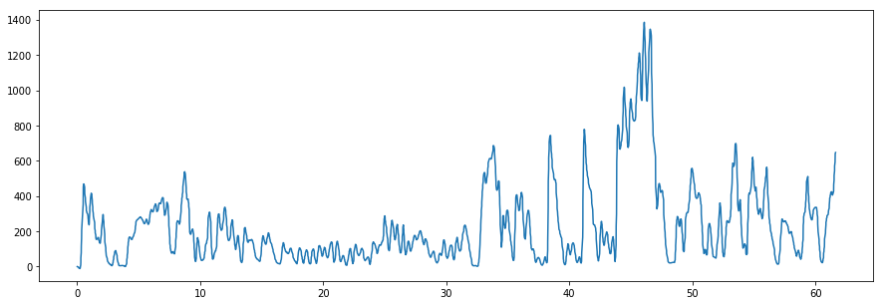
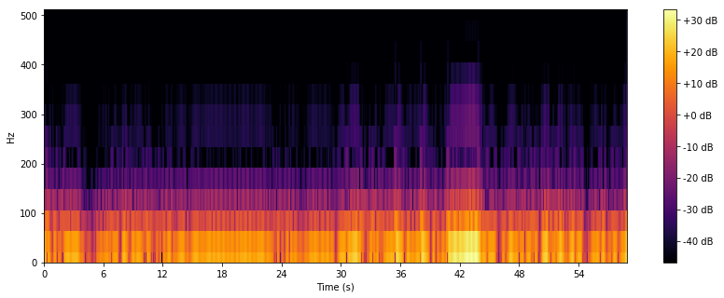
Signal processing
Signal Recorded from the sensor
of smartphone
Conversion to linear scale from Db scale
and filtering
Final Spectrogram obtained

Slide 6
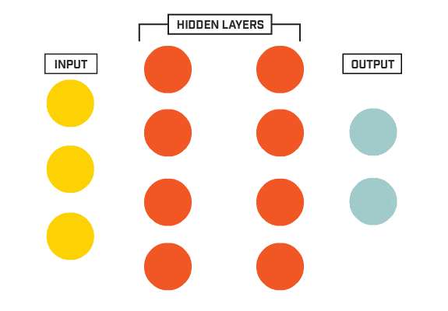
Neural Network models
For the 1° model fully-connected neural network is used; the dataset is composed by features extracted from spectrogram of ‘DecibelSource’ recorded values (MFCC, Zero_crossing_rate, Chroma_stft, Spectral_centroid, Spectral_roll_off, Spectral_bandwidth, RMS). We have an input shape of 500x28
Activation functions : ReLu, Softmax
Loss function : Sparse_categorical_Crossentropy
N° hidden layer : 3
Accuracy on test: 88%

Slide 7
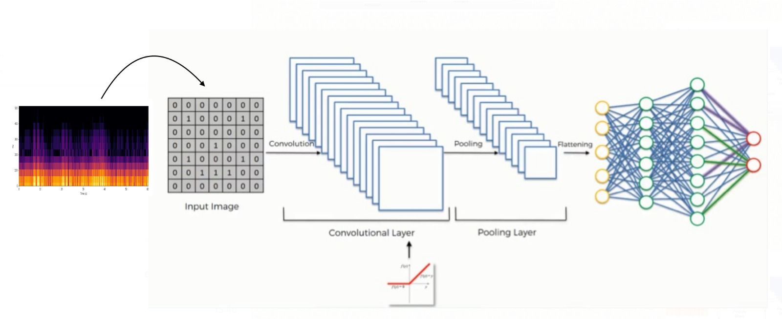

For the 2° model a Convolutional Neural Network is used; the dataset is composed by all spectrogram images (divided in 400 images on training and 100 images on test)
Input_shape : 400x360x1008x4
Kernel_size : 5x5
Stride : 2x2
Max_Pooling : 3x3
Accuracy on test: 79%

Slide 8
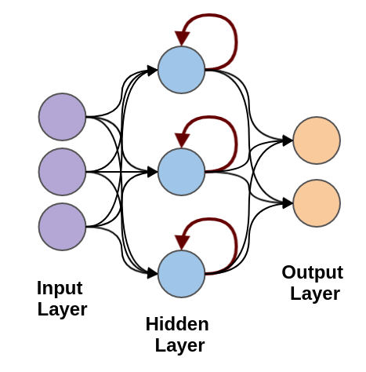
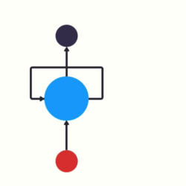
For the 3° model a Recurrent Neural Network is used; the dataset is composed by unbalanced time-series data extracted from the sensors.
LSTM unit : 256
Input_shape : 400x3000x1
Accuracy on test: 81%

Slide 9
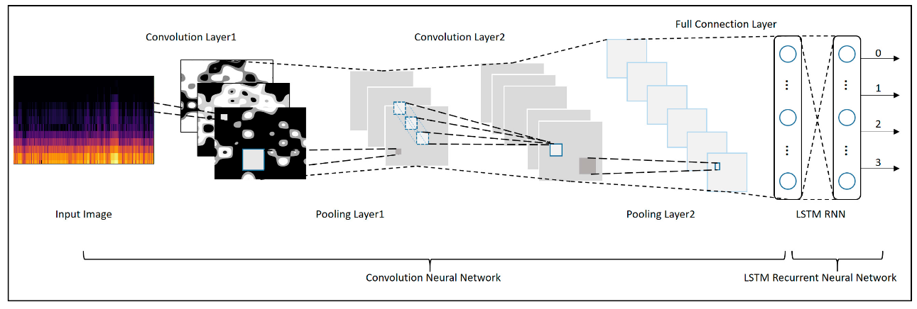
For 4° model a Convolutional Recurrent Neural Network is used: the dataset is composed by the same dataset used in the classic Convolutional Neural Network .
Input_shape : 400x360x1008x4
LTSM_unit : 40
Accuracy on test: 84%

Slide 10
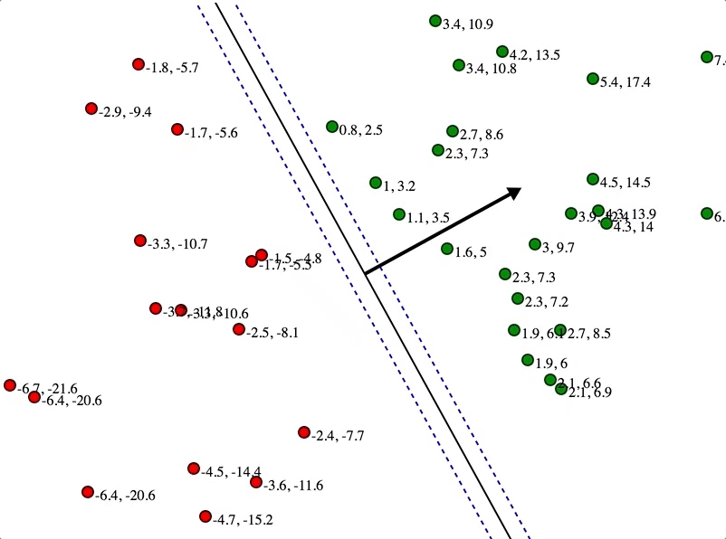
Basic Machine learning model
For the 5° model a Support vector Classifier is used: the dataset is the same of
the fully-connected neural network
Accuracy on test: 82%

Slide 11
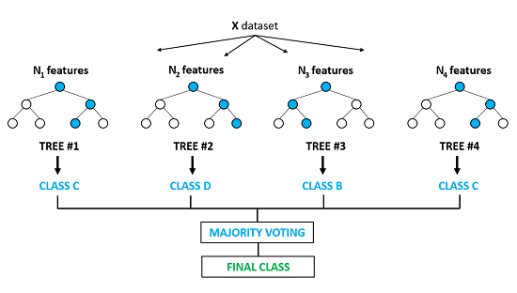
For the 6° model a Random Forest Classifier is used; again the dataset is the same of the fully-connected neural network but it is combined with a PCA (which increase the accuracy from 75% to 81%)
Accuracy on test: 81%

Slide 12
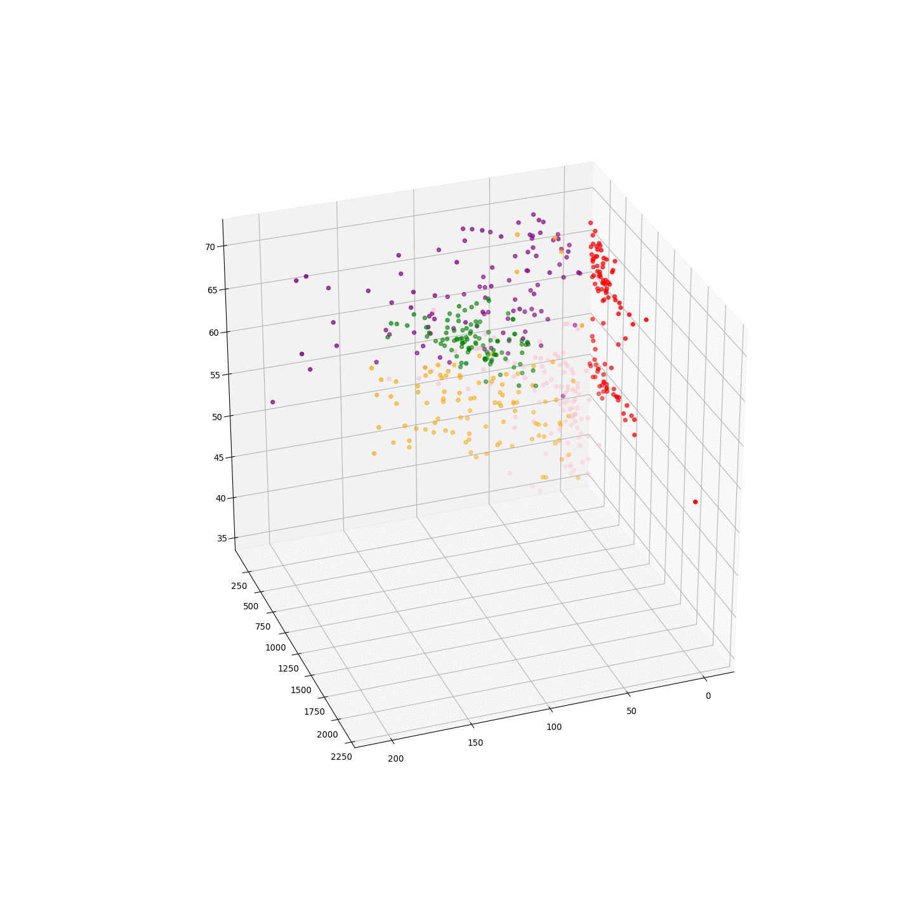
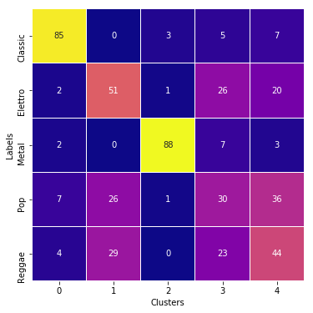
The last method used is a spectral clustering performed in the same dataset of random forest (which have a dimensionality reduction from PCA); the result is showed by a confusion matrix.
3D Scatterplot
Not so good!

Slide 13
Conclusion and improvement
Model | Accuracy
NN | 88%
CNN | 79%
RNN | 81%
CRNN | 83%
SVC | 82%
RF | 81%
The Neural network model performed better than the classic machine learning algorithm but it requires more computing power.
Clustering technique doesn’t give a significant result; it is always better to use supervised learning method for a dataset where label are present.
Having more Data!
Having more computing power!

Slide 14
Thanks for the attention

